Slide 1
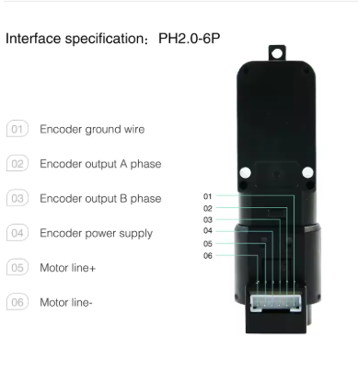
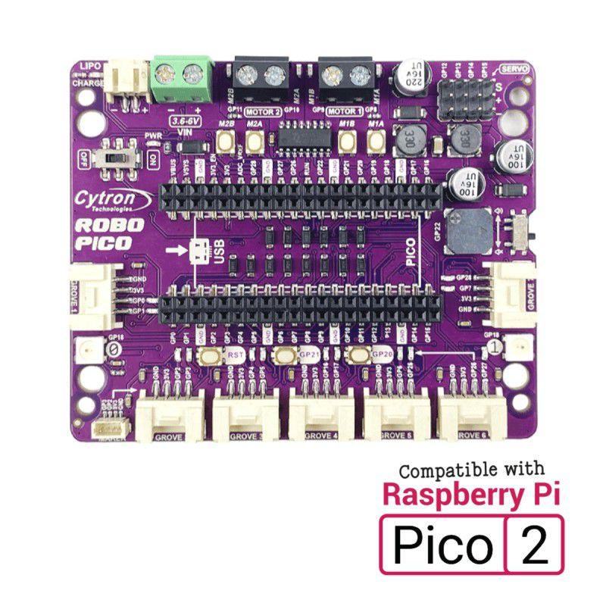








GND
POWER
BANK
3.3v
GND
3.3v
PIN 2 & 3 can use any
GPIO pins on the Pico

Slide 3
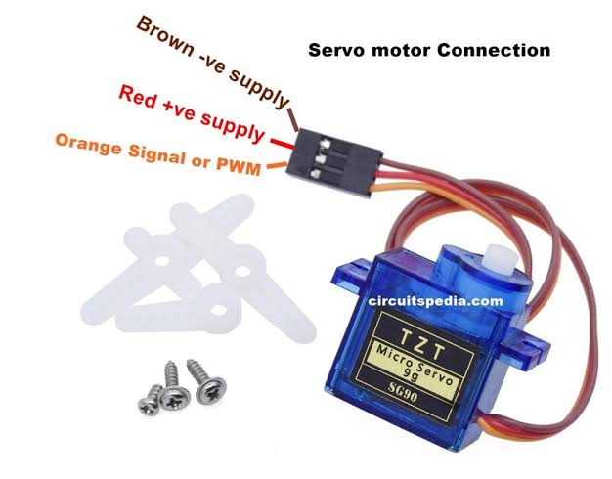




Slide 4
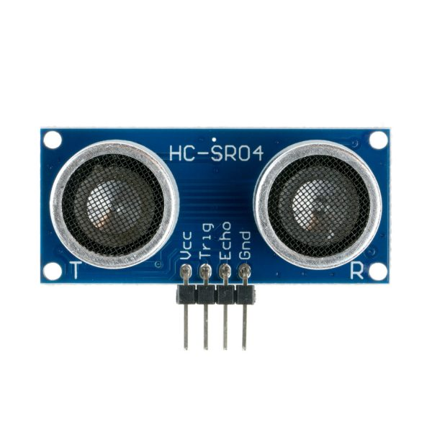
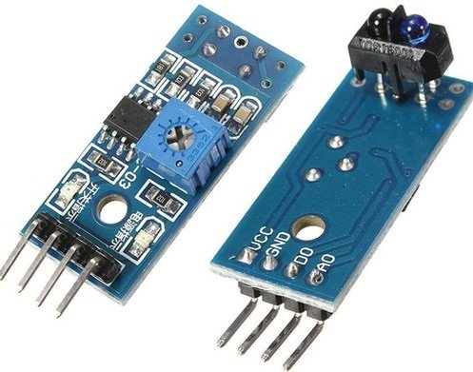




3.3v
3.3v
GND
GND
TRIG & ECHO can use any
GPIO pins on the Pico
*D0 = Digital Out (Can use any GPIO [High/Low])
*A0 = Analog Out (need to use ADC)
*Pick One

Slide 5
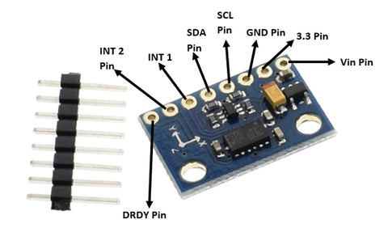

Slide 6
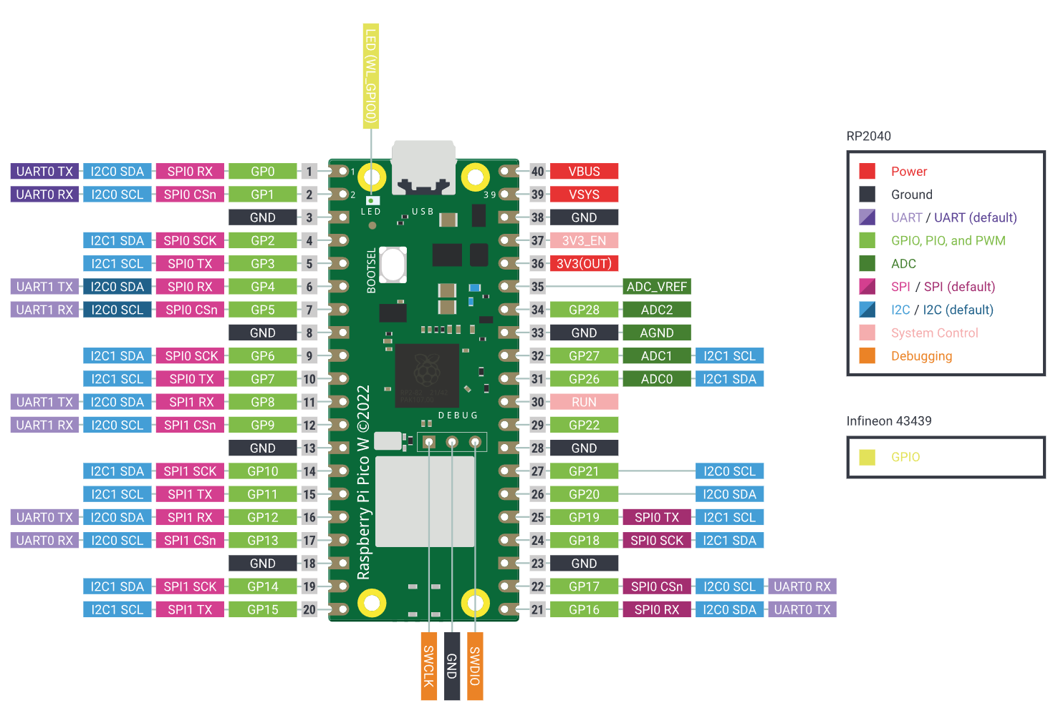

Slide 7
